Slide 1

USER GUIDES/MANUALS
A SHORT INTRODUCTION

Slide 2
Think about it!
What problem can low quality documentation create for both the readers and the writers? Discuss with reference to user guides?

Slide 3
Key terms
INSTRUCTIONAL WRITING: A writing which gives instructions to readers regarding a well-defined and specific topic.
INSTRUCTIONS: Instructions direct/teach/guide a person to do something, furnish with information needed to accomplish something.
TASK: A specific piece of work, a distinct specific action/activity

Slide 4
Key terms
PROCEDURE: It refers to manner of proceeding; a way of performing or effecting something: standard procedure.

Slide 5
DEFINITION
A user guide or user's guide, also commonly known as a manual, is a technical communication document intended to give assistance to people using a particular system.
Manuals are written guides or reference materials which are used for training, assembling mechanisms, operating machinery or equipment, servicing products, or repairing products.

Slide 6
DEFINITION
A user guide is essentially a book-length document containing instructions on installing, using, or troubleshooting a hardware or software product.

Slide 7

Who writes the guides?
Technical writer
Programmers
Product or project managers
Engineers
Other technical staff, particularly in smaller companies.

Slide 8
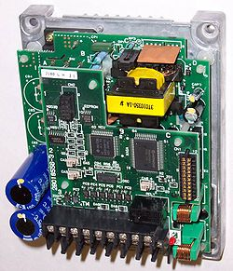
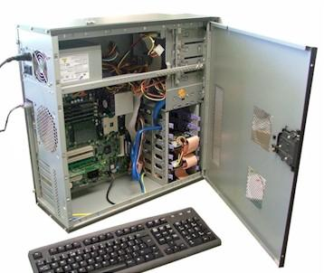

User guides are commonly associated with…..
Electronics goods
Computer hardware
Computer software

Slide 9
Components of a User Guide
Product description
Option/Function Explanations
The installation procedures
Precise Definitions (Optional)
Descriptions of mechanisms (Optional)
Step-by-step instructions of different TASKS
Analyses of processes (Optional)
Graphics
Headings

Slide 10
Components of a User Guide
Front and back covers
Title page
Edition notice
Trademarks and Disclaimers
Warranties
License agreements
TABLE OF CONTENTS
Preface, Introduction, Product description
Getting started information
Installation procedure
Operating, maintenance, and trouble shooting instructions with safety notices
APPENDIXES
Glossary
Index
Reader-comment form

Slide 11
WRITING HEADINGS
Headings should be:
Descriptive and informative.
To the point and simple (SCOPE)
Use positive language.

Slide 12
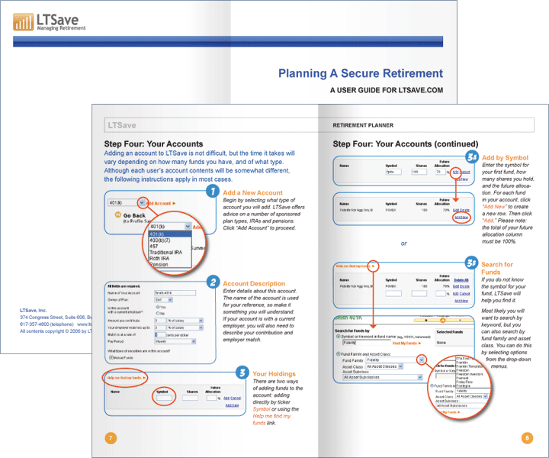
Some Examples…

Slide 13
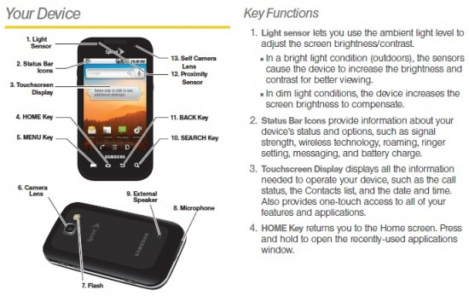
Some Examples…

Slide 14
COMMON USES OF A MANUAL
To learn and understand how to operate something
To troubleshoot
To learn how to maintain something
To learn in detail the mechanisms and processes behind different functions

Slide 15

Steps in Manual Preparation
STEP 1: Audience Analysis
1. Who will use the manual?
2. Are they novice users, intermediate level or advanced users?
3. Why do they need the guide?
4. To what extent do they require background details, definitions, explanation and analysis of mechanisms?
5. What is their competence in the language in which the manual will be written?

Slide 16
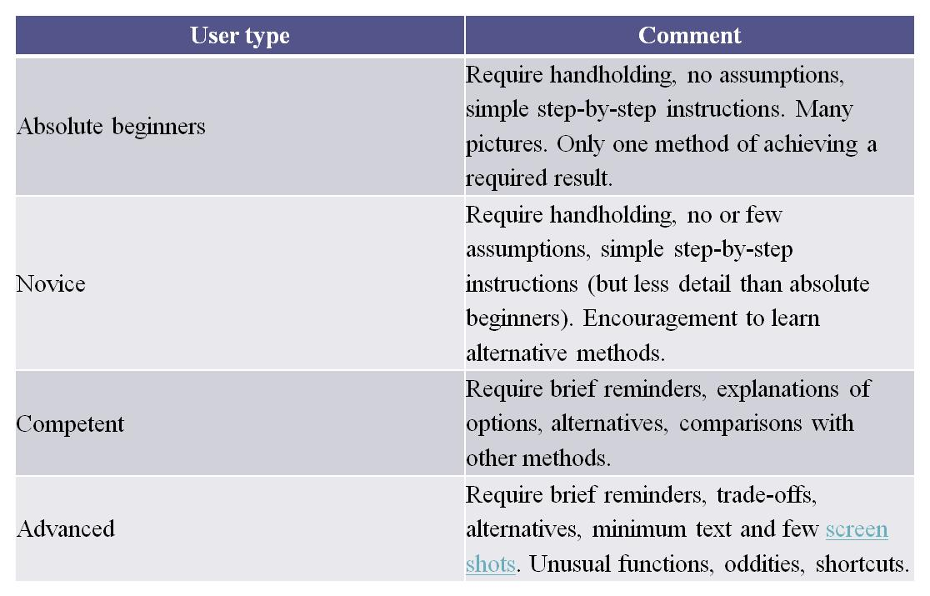

Slide 17
Steps in Manual Preparation
Considering these questions will help you develop an audience profile. Fill the form below after audience analysis.
Users: Age: Gender: Ethnic/Cultural/Educational Background: Level of technical knowledge/expertise in the field: Need for the manual: Suitable complexity level of the language, details, & the graphics: Suitable manual size and format: Appropriate style , expression, & presentations:

Slide 18

Remember!
Users usually read the documentation in desperation, after what they tried to do failed.
They're now frustrated, they have messed up things.
They're lost as to how to proceed to complete their goal.

Slide 19
Steps in Manual Preparation
STEP 2: Determining manual type
Write down the type and purpose of the manual.
For example, is the manual written for training people, or for assisting people in performing specific tasks, or for teaching laypersons all details regarding the operation and maintenance of a product, etc.

Slide 20
Steps in Manual Preparation
STEP 3: Researching content and material
Consult the engineering department to find out,
How the product works
What instructions and warnings must be stressed
Analysis and description of mechanisms and processes
Definitions of key terms
Prepare a working OUTLINE

Slide 21

In short,
TELL AUDIENCE
WHAT TO DO??
HOW TO DO??
WHY TO DO??
WHAT TO DO IN CASE OF PROBLEMS OR MALFUNCTION??

Slide 22
Steps in Manual Preparation
STEP 4: Deciding on manual production
Consider the following:
Appropriate presentation
How to provide the manual; for example, folded pamphlet or a booklet in product packaging
Decide on paper quality, print type, color usage, number of manuals, etc
Decide on any other accompanying material

Slide 23


Steps in Manual Preparation
STEP 5: Preparing the Graphics
Select suitable photographs, drawings, sketches, symbols, tables, etc.

Slide 24
Steps in Manual Preparation
STEP 6 & 7: Review the copy and Produce the manual
Editing, proofreading, and revision is done at this stage. Finally, the manual is produced.

Slide 25
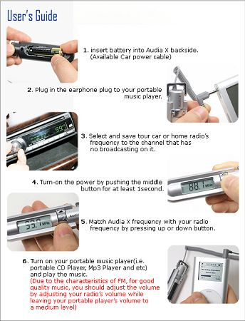
Writing Instructions

Slide 26
Writing style for Instructions
1- Imperative Mood: for primary actions to be taken
“ Load paper print side down into the printer”
2- Second person indicative mood: for additional explanatory material
“You may want to fan the paper to loosen it before loading it into the printer”
IMPORTANT:
a. Format as numbered lists to follow a certain sequence of actions
b. Format as bulleted points if no specific sequence is required to complete the task.

Slide 27
ELEMENTS OF INSTRUCTION
Prerequisites
Locations
Notices for damage/destruction
Main action/Instruction
Anticipatory troubleshooting
Before and after
Reason and Importance

Slide 28
Components of Instructions
Title
Introduction
Background
Equipment and supplies
Instructions
Step by step instructional actions to be performed
All steps should be listed under a clear, relevant heading
Notices and warning for potential problems that may cause damage
Illustrations that enable readers to visualize important actions and objects

